Slide 1
Project Management

Slide 2
Project management
Organising, planning and scheduling software projects

Slide 3
Objectives
To introduce software project management and to describe its distinctive characteristics
To discuss project planning and the planning process
To show how graphical schedule representations are used by project management
To discuss the notion of risks and the risk management process

Slide 4
Topics covered
Management activities
Project planning
Project scheduling
Risk management

Slide 5
Software project management
Concerned with activities involved in ensuring
that software is delivered on time and on
schedule and in accordance with the
requirements of the organisations developing
and procuring the software
Project management is needed because software development is always subject to budget and schedule constraints that are set by the organisation developing the software

Slide 6
Software management distinctions
The product is intangible
    (cannot be seen or touched)
Software engineering is not recognized as an engineering discipline with the sane status as mechanical, electrical engineering, etc.
The software development process is not
standardised
Many software projects are 'one-off' projects

Slide 7
Management activities
Proposal writing
Project planning and scheduling
Project costing
Project monitoring and reviews
Personnel selection and evaluation
Report writing and presentations

Slide 8
Management commonalities
These activities are not peculiar to software
management
Many techniques of engineering project
management are equally applicable to software project management
Technically complex engineering systems tend to suffer from the same problems as software systems

Slide 9
Project staffing
May not be possible to appoint the ideal people to work on a project
  Project budget may not allow for the use of highly-paid staff
  Staff with the appropriate experience may not be available
  An organisation may wish to develop employee skills on a software project
Managers have to work within these constraints especially when (as is currently the case) there is an international shortage of skilled IT staff

Slide 10
Project planning
Probably the most time-consuming project management activity
Continuous activity from initial concept through to system delivery. Plans must be regularly revised as new information becomes available
Various different types of plan may be developed to support the main software project plan that is concerned with schedule and budget

Slide 11
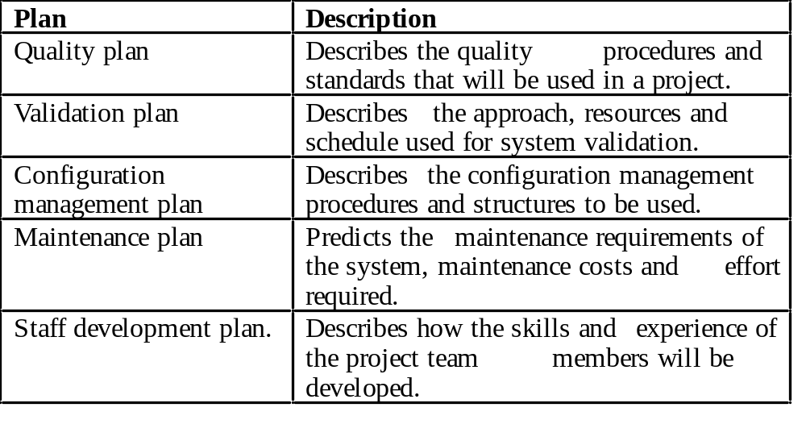
Types of project plan

Slide 12
Project plan structure
Introduction
Project organisation
Risk analysis
Hardware and software resource requirements
Work breakdown
Project schedule
Monitoring and reporting mechanisms

Slide 13
Activity organization
Activities in a project should be organised to produce tangible outputs for management to judge progress
Milestones are the end-point of a process activity
Deliverables are project results delivered to customers
The waterfall process allows for the straightforward definition of progress milestones

Slide 14
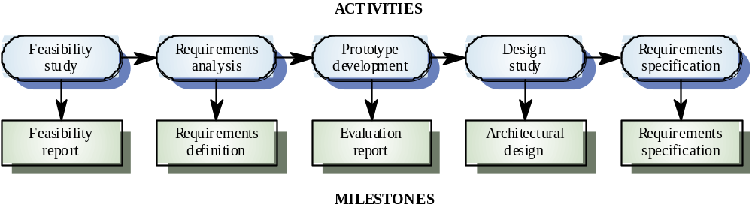
Milestones in the RE process

Slide 15
Project scheduling
Split project into tasks and estimate time and resources required to complete each task
Organize tasks concurrently to make optimal
use of workforce
Minimize task dependencies to avoid delays
caused by one task waiting for another to complete
Dependent on project managers intuition and experience

Slide 16
Scheduling problems
Estimating the difficulty of problems and hence the cost of developing a solution is hard
Productivity is not proportional to the number of people working on a task
Adding people to a late project makes it later because of communication overheads
The unexpected always happens. Always allow contingency in planning

Slide 17
Bar charts and activity networks
Graphical notations used to illustrate the project schedule
Show project breakdown into tasks. Tasks should not be too small. They should take about a week or two
Activity charts show task dependencies and the the critical path
Bar charts show schedule against calendar time

Slide 18
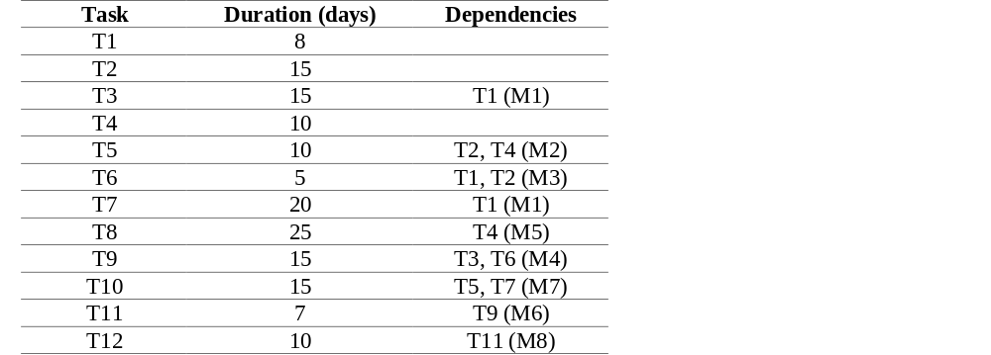
Task durations and dependencies

Slide 19
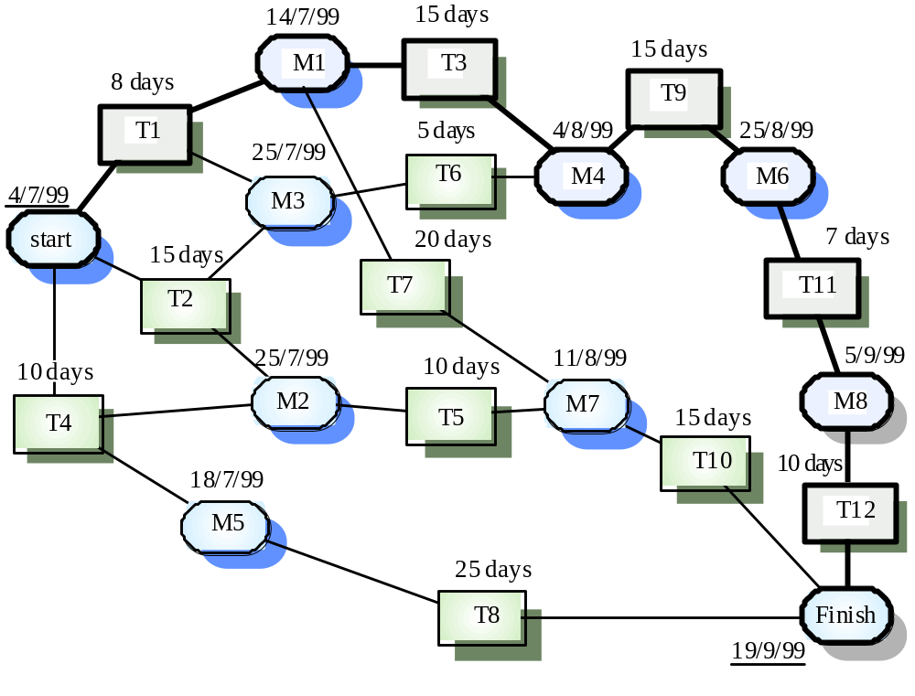
Activity network

Slide 20
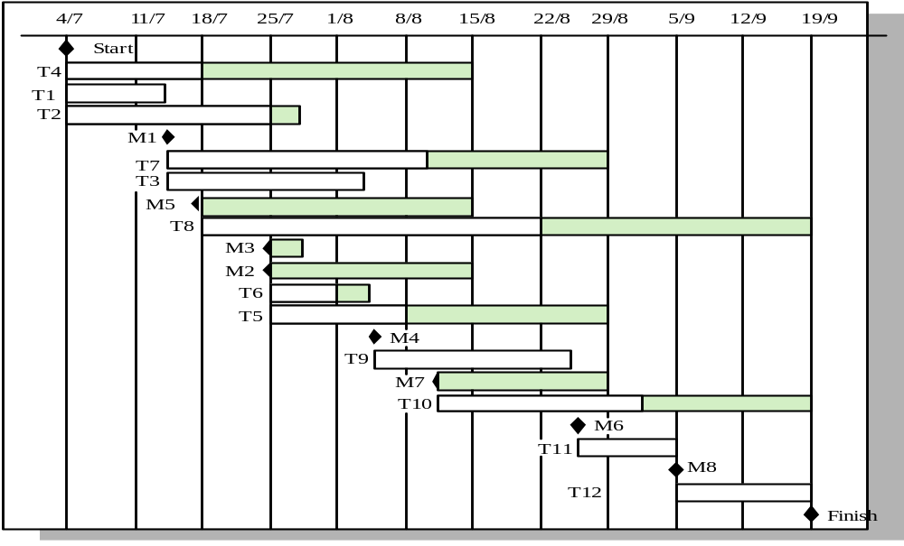
Activity timeline

Slide 21
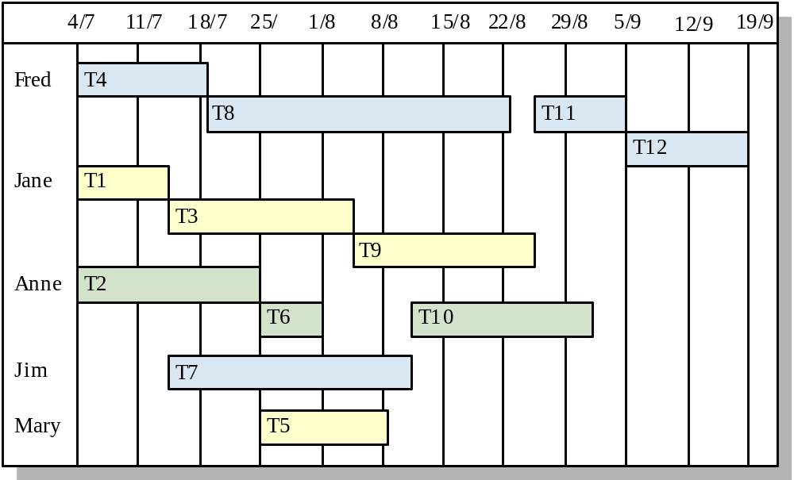
Staff allocation

Slide 22
Risk management
Risk management is concerned with identifying risks and drawing up plans to minimise their effect on a project.
A risk is a probability that some adverse circumstance will occur.
  Project risks affect schedule or resources
  Product risks affect the quality or performance of the software being developed
  Business risks affect the organisation developing or procuring the software

Slide 23
The risk management process
Risk identification
  Identify project, product and business risks
Risk analysis
  Assess the likelihood and consequences of these risks
Risk planning
  Draw up plans to avoid or minimise the effects of the risk
Risk monitoring
  Monitor the risks throughout the project

Slide 24
Risk identification
Technology risks
People risks
Organisational risks
Requirements risks
Estimation risks

Slide 25
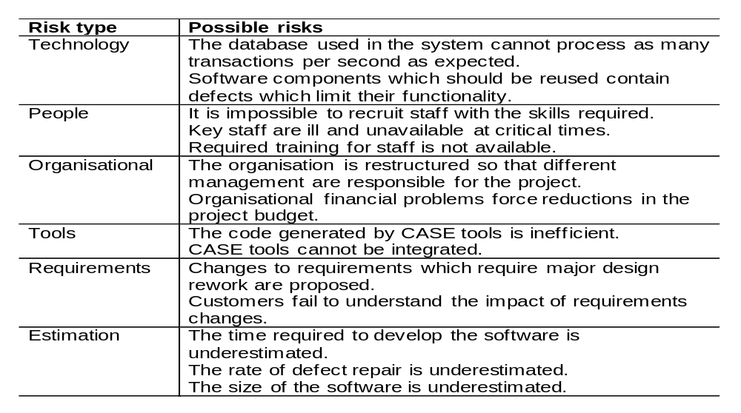
Risks and risk types

Slide 26
Risk analysis
Assess probability and seriousness of each risk
Probability may be very low, low, moderate, high or very high
Risk effects might be catastrophic, serious, tolerable or insignificant

Slide 27
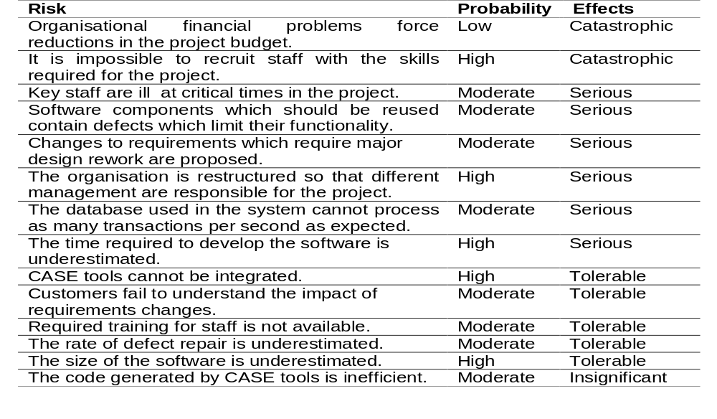
Risk analysis

Slide 28
Risk planning
Consider each risk and develop a strategy to manage that risk
Avoidance strategies
  The probability that the risk will arise is reduced
Minimisation strategies
  The impact of the risk on the project or product will be reduced
Contingency plans
  If the risk arises, contingency plans are plans to deal with that risk

Slide 29
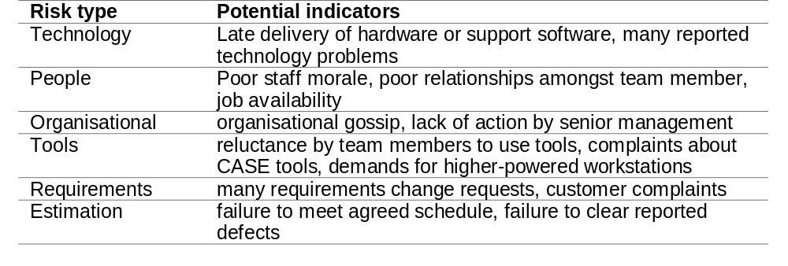
Risk factors

Slide 30
Key points
Good project management is essential for project success
The intangible nature of software causes problems for management
Managers have diverse roles but their most significant activities are planning, estimating and scheduling
Planning and estimating are iterative processes
which continue throughout the course of a
project

Slide 31
Key points
A project milestone is a predictable state where
some formal report of progress is presented to management.
Risks may be project risks, product risks or business risks
Risk management is concerned with identifying risks which may affect the project and planning to ensure that these risks do not develop into major threats

